Slide 1
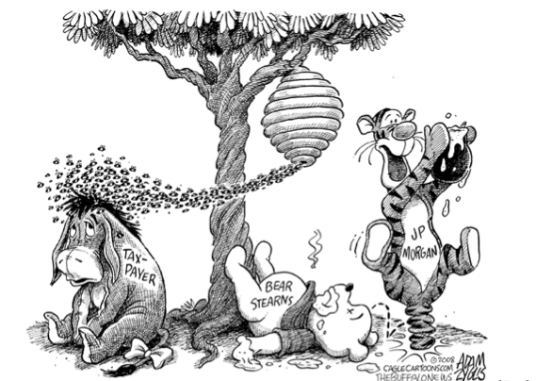


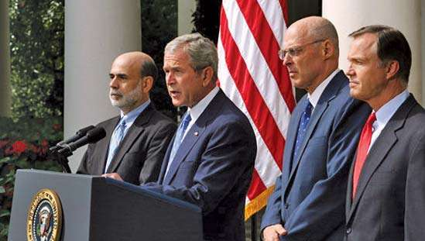
Why bank failures
Government
Payment system
Aggregate supply
GFC
© Cagle Cartoons Inc Adam Zyglis (2008)
2007
Notes:
GONZALES’HERMOSILLO 1999

Slide 2
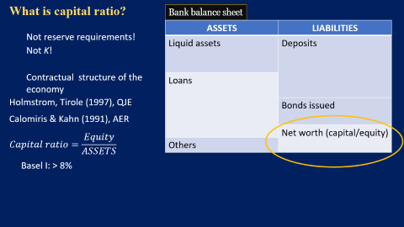

A brief history
Arena (2005), JB&F
Acharya & Mora (2015), JoF
Gonzales-Hermosillo 1999
Tirole & Farhi (2012), AER
Diamond & Dybvig (1983), JPE
Walther (2016), JMCB
Berger 1995, JMCB
Europe sovereign debt crisis
USA:Savings & loan crisis
Asian financial crisis
GFC
Tequila crisis
2014: Europa Single Resolution Board
1988 Basel I
2004 Basel II
2013 Basel III
1986
1990
1995
1997
2007
2013
Notes:
GONZALES’HERMOSILLO 1999

Slide 3


Two facts
Size of the banking system in the USA on August the 1st 2007
1. Amplification effect
$$\$ 10×{10}^{12}$$
Total losses from the Asset Backup Commercial Paper market(ABCP)
$$\$ 0.48×{10}^{12}$$
Gorton, Metrick 2012, p16
https://fred.stlouisfed.org/series/TLAACBW027SBOG
Notes:
Radio big circle 8.02 with area 202.32
Radio small circle 1.75 with area 9.71 (=4.8% of the area of the big circle = 0.48/10)

Slide 4
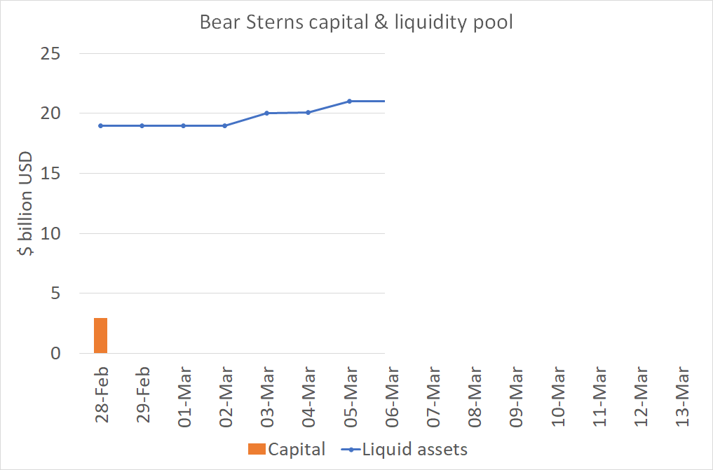
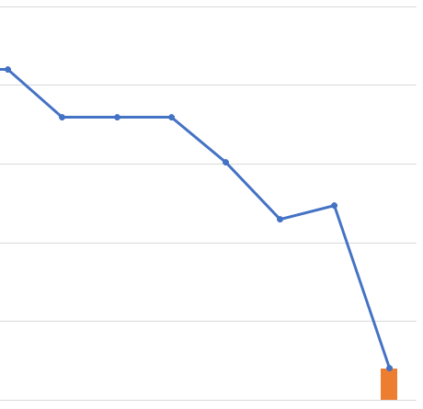

Two facts
2.Bear Stearns collapse
Chairman Cox Letter to Basel Committee
“even at the time of its sale on Sunday, Bear Stearns' capital (…) exceeded supervisory standards.”
“the fate of Bear Stearns was the result of a lack of confidence, not a lack of capital”
“Bear Stearns had a capital ratio of well in excess of the 10% level used by the Federal Reserve Board in its ‘well-capitalized’ standard.”
https://www.sec.gov/news/press/2008/2008-48.htm
Notes:
LOLR: was the Fed able to help Bear Stearns as a LOLR?

Slide 5









Hypothesis
Network effects
Allen & Gale 2000, JPE
Acemoglu, Carvalho, Ozdaglar Tahbaz-Salehi (2012), Econometrica
Acemoglu, Ozdaglar Tahbaz-Salehi (2015), AER
Diamond & Rajan (2005), JoF
$$p_{i}^{∗}$$
$$p_{j}^{∗}$$
$$p_{i}^{∗}$$
$$p_{j}^{∗}$$
$$p_{k}^{∗}$$
$$p_{k}^{∗}$$
“Virtually all such studies find that low capital ratios raise the probability of bank failure.”
Berger & Roman (2020)
Estimation
Data on the network
Notes:
Is the same?
Are more connected system more resilient? Depends
Diamond & Rajan: you don’t need a network to have contagious, amplyfing effects. All banks are connected through markets.
What it does not say: an arbitrary macro shocks does not generate contagious.

Slide 6






Diamond & Rajan 2005
T0: state of nature is realized.
White blank is solvent, it doesn’t liquidiate late projects.
Black white is not solvent, depositors run on it.
$$t=2$$
$$t=0$$
$$t=0.5$$
$$t=1$$
State known
40
$$c_{1}+\frac{c_{2}}{r}$$
10
Aggregate shock
40% late projects
10% late projects
Depositors run
Why does r rise?
The solvent bank must liquidate project

Slide 7




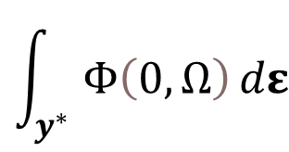













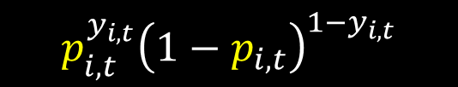




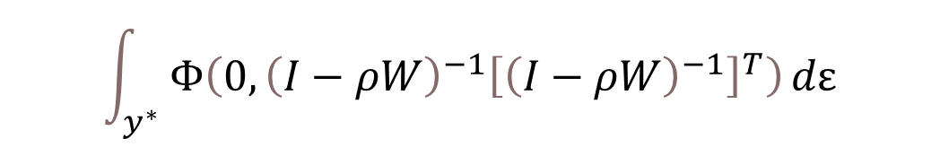











Estimation
$$y_{i,t}^{∗}=ρ\left(w_{j,t}y_{j,t}^{∗}+w_{h,t}y_{h,t}^{∗}\right)+x_{i,t}^{T}β+ε_{i,t}$$
$$ε_{i,t }∼𝒩\left(0,1\right)$$
Probit case
$$y_{i,t}^{∗}=x_{i,t}^{T} β + u_{i,t}^{∗}$$
$$u_{i,t }^{∗}∼𝒩\left(0,1\right)$$
$$y^{∗}=ρWy^{∗}+Xβ+ε$$
$$y_{i,t}=x_{i,t}^{T} β+u_{t}$$
i i d
$$y^{∗}=ρWy^{∗}+Xβ+ε$$
$$y_{t}^{∗}={\left(I−ρW\right)}^{−1} Xβ +{\left(I−ρW\right)}^{−1}ε$$
$$p_{i,t}$$
$$y_{i,t}∼ℬinomial\left(N=1,p_{i,t}\right)$$
$$y_{i,t}=$$
$$1$$
with probability
$$p_{i,t}^{y_{i,t}}{\left(1−p_{i,t}\right)}^{1−y_{i,t}}$$
$$Φ\left[x_{i,t}^{T} β \right]$$
$p_{i,t}$ $=$
$$x_{i,t}^{T}β$$
$${1−p}_{i,t}$$
$$¿?$$
$$0$$
with probability
$$P\left(Y_{i,t}=1\right)=$$
$${Φ\left[x^{T} β\right]}_{i,t}^{y_{i,t}}{\left(1−{Φ\left[x^{T} β\right]}_{i,t}\right)}^{1−y_{i,t}}$$
$$ν$$
$$∼𝒩$$
Likelihood function
$$(0,$$
$$?)$$
$${\left(I−ρW\right)}^{−1}{\left[{\left(I−ρW\right)}^{−1}\right]}^{T}$$
$$ℒ_{𝒾,𝓉}=f\left(y_{i,t}^{} | x_{t};β\right)=$$
$$Ω=E\left[νν^{T}\right]$$
$$\prod_{i=1}^{N}{}$$
$$Ω={\left(I−ρW\right)}^{−1}{\left[{\left(I−ρW\right)}^{−1}\right]}^{T}$$
$$ℒ_{𝓉}=f\left(y_{t}^{} | X_{t};β\right)=$$
$${Φ\left[x^{T} β\right]}_{i,t}^{y_{i,t}}{\left(1−{Φ\left[x^{T} β\right]}_{i,t}\right)}^{1−y_{i,t}}$$
$$ℒ_{𝒾,𝓉}=f\left(y^{∗} | X_{t−1},y;β, ρ \right)=$$
$$Φ\left(0,Ω\right)$$
Newton-Raphson algorithm
$$\int_{y^{∗}}{Φ\left(0,Ω\right)}dε$$
$$\int_{y^{∗}}{Φ\left(0,{\left(I−ρW\right)}^{−1}{\left[{\left(I−ρW\right)}^{−1}\right]}^{T}\right)}dε$$
Efficient importance sampling
Simulated Maximum Likelihood
EIS-SML
Notes:
You want the estimate the asterisk model where the shocks are Normal(0,1). These shocks can be think of the shocks bank faces like ratio of late-paying borowwers.
You can’t cause there are unobservables.
You estimate with the observables.
Recognized that with observables the dependant is binomial. What is the value of p?
Well, you let p to depend on X, that is, you parametized p. The link function is the Normal Density. Why? Cause shocks in the structural are Normal

Slide 8









































Estimation
Probit case
Probit spatial autorregresive (SAR)
$$y_{i,t}^{∗}=x_{i,t}^{T} β + u_{i,t}^{∗}$$
$$u_{i,t }^{∗}∼𝒩\left(0,1\right)$$
$$y_{i,t}^{∗}=$$
$$ρ\left(w_{j,t}y_{j,t}^{∗}+w_{h,t}y_{h,t}^{∗}\right)+$$
$$x_{i,t}^{T}β+ε_{i,t}$$
$$ε_{i,t }∼𝒩\left(0,1\right)$$
$$y_{i,t}=x_{i,t}^{T} β+u_{t}$$
i i d
$$y^{∗}=ρW y^{∗}+Xβ+ε$$
$$ε∼𝓝\left(0,I\right)$$
$$y_{t}^{∗}={\left(I−ρW\right)}^{−1} Xβ +{\left(I−ρW\right)}^{−1}ε$$
Sparse matrix algorithms: Pace & LeSage (2011)
$$p_{i,t}$$
$$y_{i,t}∼ℬinomial\left(N=1,p_{i,t}\right)$$
$$y_{i,t}=$$
$$1$$
with probability
$$p_{i,t}^{y_{i,t}}{\left(1−p_{i,t}\right)}^{1−y_{i,t}}$$
$$Φ\left[x_{i,t}^{T} β \right]$$
$$ν$$
$$∼𝒩$$
$$?)$$
$$Ω=E\left[νν^{T}\right]$$
$p_{i,t}$ $=$
$$x_{i,t}^{T}β$$
$$(0,$$
$${\left(I−ρW\right)}^{−1}{\left[{\left(I−ρW\right)}^{−1}\right]}^{T})$$
$${1−p}_{i,t}$$
$$¿?$$
$$0$$
with probability
$$P\left(Y_{i,t}=1\right)=$$
Likelihood function
$$Ω=$$
$${\left(I−ρW\right)}^{−1}{\left[{\left(I−ρW\right)}^{−1}\right]}^{T}$$
Likelihood function
$${Φ\left[x^{T} β\right]}_{i,t}^{y_{i,t}}{\left(1−{Φ\left[x^{T} β\right]}_{i,t}\right)}^{1−y_{i,t}}$$
$$ℒ_{𝒾,𝓉}=f\left(y^{∗} | X_{i, t−1};β, ρ \right)=$$
$$Φ_{i}\left(0,Ω\right)$$
i i d
$$ℒ_{𝒾,𝓉}=f\left(y_{i,t}^{} | x_{t};β\right)=$$
$$\int_{y^{∗}}{Φ\left(0,Ω\right)}dε$$
$$ℒ=f\left(y^{∗} | X_{i, t−1};β, ρ \right)=$$
$$ℒ=f\left(y^{∗} | X_{i, t−1};y, β, ρ \right)=$$
N-dimensional !
$$\prod_{i=1}^{N}{}$$
$$ℒ_{𝓉}=f\left(y_{t}^{} | X_{t};β\right)=$$
$${Φ\left[x^{T} β\right]}_{i,t}^{y_{i,t}}{\left(1−{Φ\left[x^{T} β\right]}_{i,t}\right)}^{1−y_{i,t}}$$
Efficient importance sampling
Simulated Maximum Likelihood
EIS-SML estimator
Elhorst, Heijnen, Samarina, Jacobs (2017), JAE
$$\int_{y^{∗}}{Φ\left(0,{\left(I−ρW\right)}^{−1}{\left[{\left(I−ρW\right)}^{−1}\right]}^{T}\right)}dε$$
Newton-Raphson algorithm
Notes:
2 little problems:
The inversion of the matrix I-pW, it’s a NxN matrix! That takes N^3 iterations. Sparse matrix algorithms Pace, R. Kelley, and James P. LeSage. "Fast Simulated Maximum Likelihood Estimation of the Spatial Probit Model Capable of Handling Large Samples, chapter 1." (2011): 3-34.
The more fundamental problem of the likelihood. The value for a particular observation depends on the others!!

Slide 9










Estimation
Probit case
Probit spatial autorregresive (SAR)
$$y_{i,t}^{∗}=x_{i,t}^{T} β + u_{i,t}^{∗}$$
$$u_{i,t }^{∗}∼𝒩\left(0,1\right)$$
$$y^{∗}=ρW y^{∗}+Xβ+ε$$
$$ε∼𝓝\left(0,I\right)$$
$$y_{i,t}=x_{i,t}^{T} β+u_{t}$$
i i d
Sparse matrix algorithms: Pace & LeSage (2011)
Likelihood function
Likelihood function
i i d
$$p_{i,t}$$
$$y_{i,t}∼ℬinomial\left(N=1,p_{i,t}\right)$$
$$y_{i,t}=$$
$$1$$
with probability
$$p_{i,t}^{y_{i,t}}{\left(1−p_{i,t}\right)}^{1−y_{i,t}}$$
$$Φ\left[x_{i,t}^{T} β \right]$$
$p_{i,t}$ $=$
$$x_{i,t}^{T}β$$
$${1−p}_{i,t}$$
$$¿?$$
$$0$$
with probability
$$P\left(Y_{i,t}=1\right)=$$
$$\int_{y^{∗}}{Φ\left(0,Ω\right)}dε$$
$${Φ\left[x^{T} β\right]}_{i,t}^{y_{i,t}}{\left(1−{Φ\left[x^{T} β\right]}_{i,t}\right)}^{1−y_{i,t}}$$
$$ℒ_{𝓉}=f\left(y_{t}^{} | X_{t};β\right)=$$
$$ℒ=f\left(y^{∗} | X_{i, t−1};y, β, ρ \right)=$$
$$\prod_{i=1}^{N}{}$$
$${Φ\left[x^{T} β\right]}_{i,t}^{y_{i,t}}{\left(1−{Φ\left[x^{T} β\right]}_{i,t}\right)}^{1−y_{i,t}}$$
$$ℒ_{𝒾,𝓉}=f\left(y_{i,t}^{} | x_{t};β\right)=$$
Efficient importance sampling
Simulated Maximum Likelihood
Newton-Raphson algorithm
EIS-SML estimator
Elhorst, Heijnen, Samarina, Jacobs (2017), JAE
$$\int_{y^{∗}}{Φ\left(0,{\left(I−ρW\right)}^{−1}{\left[{\left(I−ρW\right)}^{−1}\right]}^{T}\right)}dε$$
Notes:
2 little problems:
The inversion of the matrix I-pW, it’s a NxN matrix! That takes N^3 iterations. Sparse matrix algorithms Pace, R. Kelley, and James P. LeSage. "Fast Simulated Maximum Likelihood Estimation of the Spatial Probit Model Capable of Handling Large Samples, chapter 1." (2011): 3-34.
The more fundamental problem of the likelihood. The value for a particular observation depends on the others!! N-dimensional

Slide 10
Network data
Interbank loans
(Overnight) interbank market
 | Bank A | Bank B | Bank C | TOTAL
Bank A | 0 | ? | ? | 100
Bank B | ? | 0 | ? | 120
Bank C | ? | ? | 0 | 15
TOTAL | 60 | 25 | 150 | 0
Balance sheet data
Credit registry
Central Bank
Notes:
Bank mutual relations comprise multiple areas: syndicated loans market (many banks lending the same borrower), overnight interbank market, derivative positions (or swaps), wholesale deposit market. We only consider loans reported in the credit registry.
Interbank market data relies on trading data. In some cases the identities of the parties is unknown

Slide 11
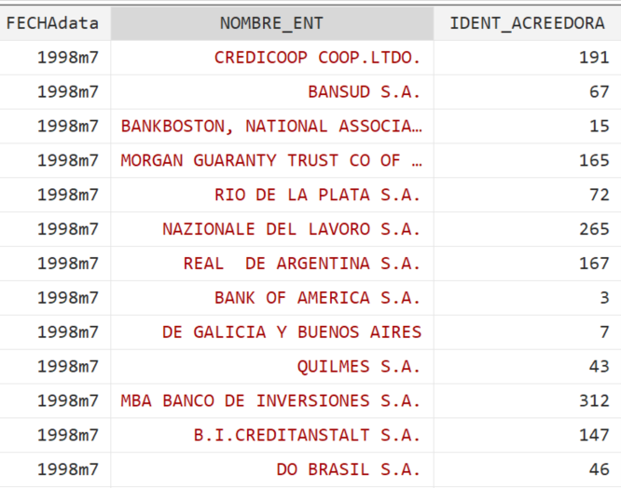
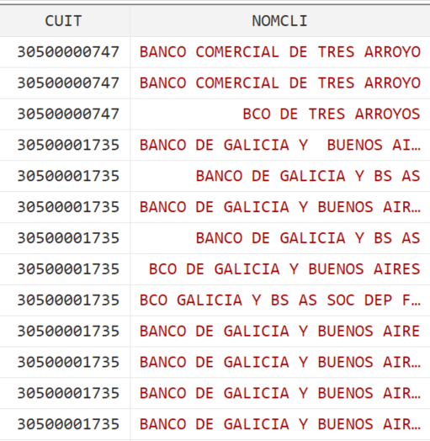
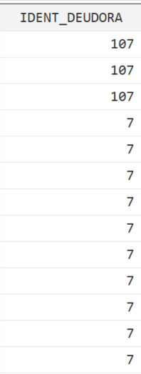
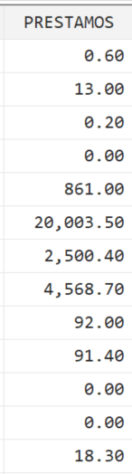
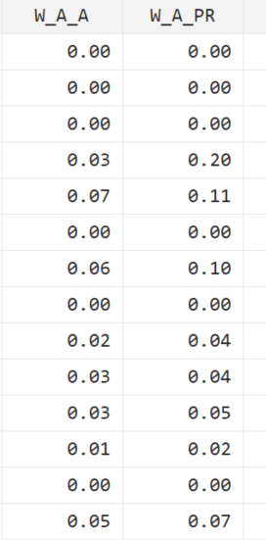
Network data
Credit registry
Weighted edges (links) from lender bank
Loan $
Lender bank ID
(Overnight) interbank market
Borrower TFN
Borrower bank ID
Interbank loans
Balance sheet data
 | Bank A | Bank B | Bank C | TOTAL
Bank A | 0 | ? | ? | 100
Bank B | ? | 0 | ? | 120
Bank C | ? | ? | 0 | 15
TOTAL | 60 | 25 | 150 | 0
Notes:
Bank mutual relations comprise multiple areas: syndicated loans market (many banks lending the same borrower), overnight interbank market, derivative positions (or swaps), wholesale deposit market. We only consider loans reported in the credit registry.
Interbank market data relies on trading data. In some cases the identities of the parties is unknown

Slide 12
Network data
Credit registry
Weighted edges (links) from lender bank
# Links | # lender banks | # borrower banks | Average loan size (% lender total loans)
480 | 75 | 77 | 0.88
Ws_basic_probit.html
Notes:
Bank 317 ‘DE RIO NEGRO SA’
file:///C:/Users/emi.ABLE-22868/OneDrive/UWA%20PhD/bankFailure/code/network/Ws_basic_probit.html

Slide 13
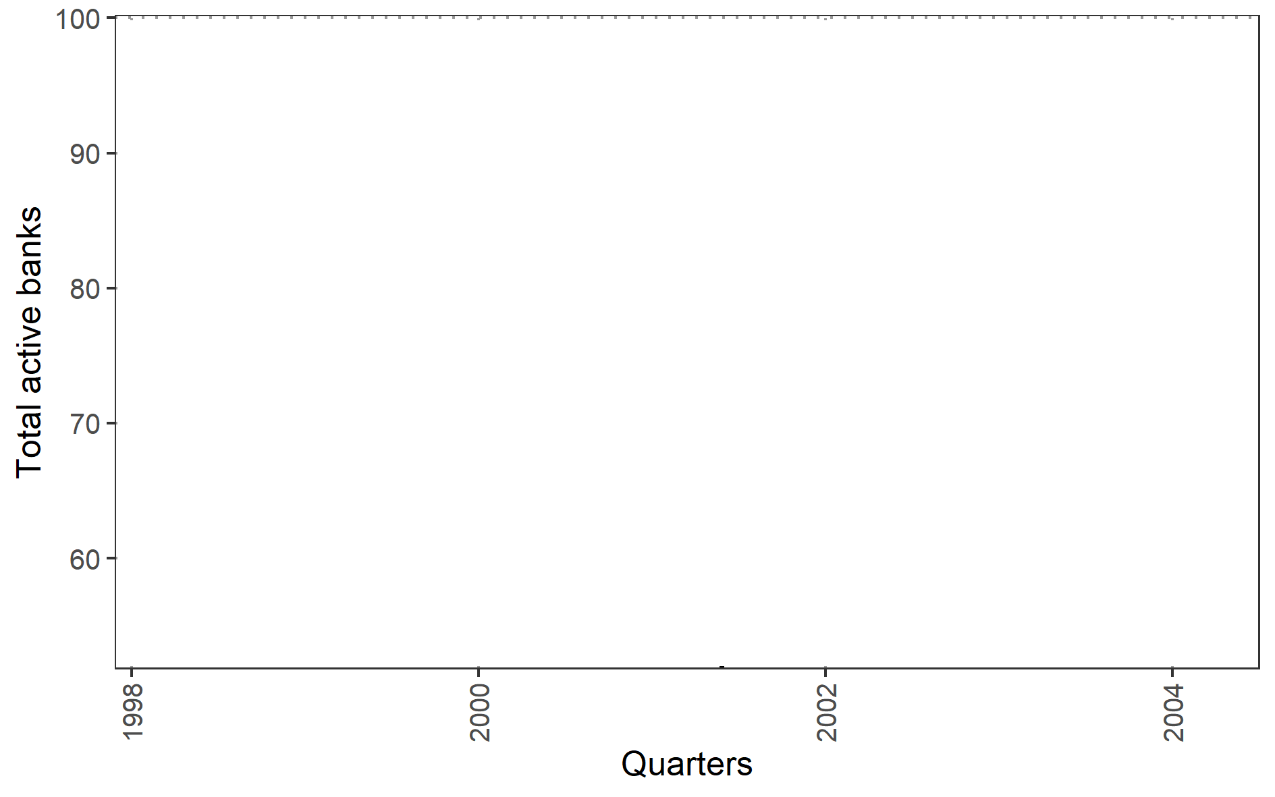
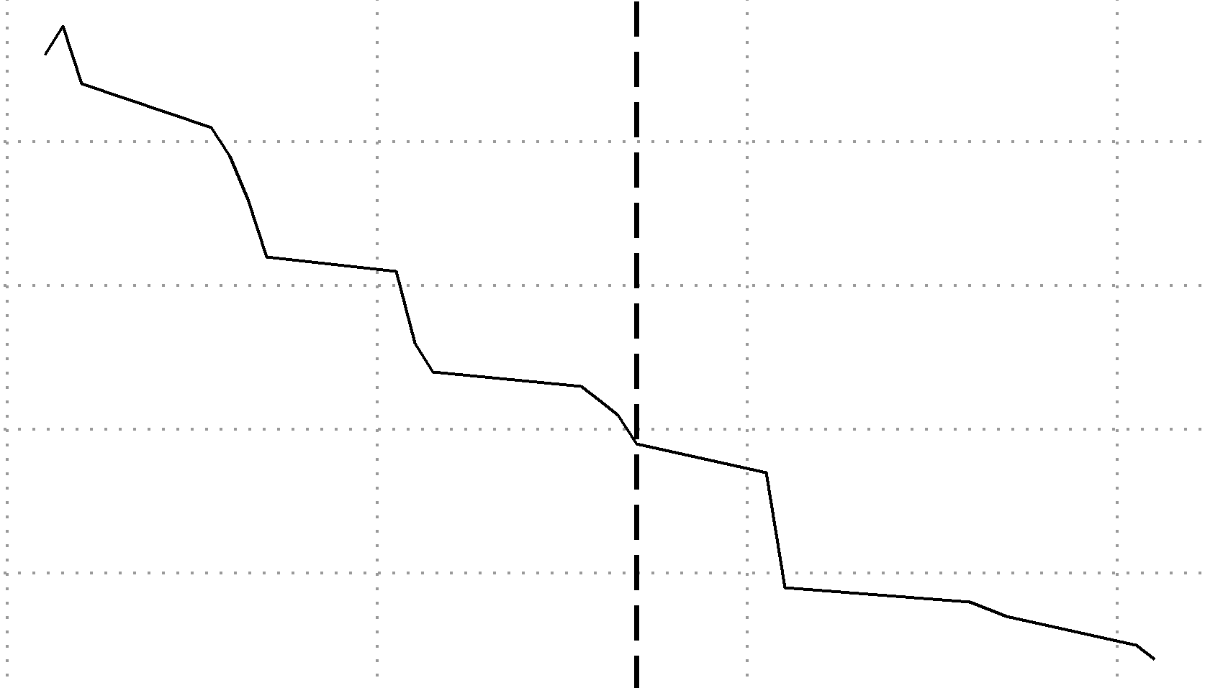
Descriptive statistics
Failure
Any official exit
New federal govt.
Federal govt. collapsed
Fed tightening
Currency board abandoned
New federal govt.
Brazil devaluation
Variable | Mean | SD
Assets (ARS$/USD billions) | 1,047.00 | 2,168.00
Capital (%) | 16.28 | 12
Non-performing loans (%) | 9.43 | 10
ROA (%) | 0.51 | 3
Deposits interest rate (%) | 5.36 | 3
Loans interest rate (%) | 23.64 | 10
Lending to public sector (% loans) | 3.85 | 9
USD loans (% loans) | 55.55 | 23
Loans-to-Assets (%) | 50.35 | 17
5 Presidents
 | 1998
N | 105.00
SampleStart | 1998
Failure until | 2001
SurvivalRate | 0.66
2001q4
Notes:
Include M&A
s98.Priv.01.onT
: 1998 annual data results/probit/failureUntil2001q4/probits-AnnualData.html
Brazil, Russian default, Fed tightening

Slide 14
Descriptive statistics
Variable | Mean | SD
Assets (ARS$/USD billions) | 1,047.00 | 2,168.00
Capital (%) | 16.28 | 12
Non-performing loans (%) | 9.43 | 10
ROA (%) | 0.51 | 3
Deposits interest rate (%) | 5.36 | 3
Loans interest rate (%) | 23.64 | 10
Lending to public sector (% loans) | 3.85 | 9
USD loans (% loans) | 55.55 | 23
Loans-to-Assets (%) | 50.35 | 17
Predictors at 1998 (annual average)
Failure horizon is 2001q4
N | 105
SampleStart | 1998
Failure until | 2001
SurvivalRate | 0.66
Notes:
s98.Priv.01.onT
: 1998 annual data results/probit/failureUntil2001q4/probits-AnnualData.html

Slide 15
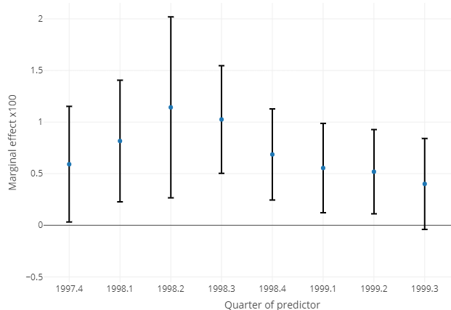







Results
 | Survival probability
 | Coefficients x 100
Capital ratio | 2.36 | **
Non-perfoming loans ratio | -3.10
Deposits interest rate (%) | 8.86 | *
Loans interest rate (%) | 1.33
ROA (%) | 8.82
Lending to public sector ratio | 9.48 | **
USD loans percentage (%) | 0.02
Loans-to-Assets ratio | 0.20
N | 105
AIC | 121
logLik (df=10) | -50.55
Probit case
Predictors at 1998 (annual average)
Failure horizon is 2001q4
$$y_{i,t}^{∗}=x_{i,t}^{T} β + u_{i,t}^{∗}$$
$$u_{i,t }^{∗}∼𝒩\left(0,1\right)$$
$$\sum_{i=1}^{N}{}$$
$$E\hat{\left[\frac{∂y_{i}^{∗}}{∂x_{k,i}}\right]}=$$
$$φ\left( x_{i}^{T} \hat{β}\right)$$
$$\hat{β_{k}}$$
Marginal effect capital (at 90%)
$$E\hat{\left[\frac{∂y_{i}^{∗}}{∂x_{cap,i}}\right]}=0.88±0.33$$
Notes:
Bank mutual relations comprise multiple areas: syndicated loans market (many banks lending the same borrower), overnight interbank market, derivative positions (or swaps), wholesale deposit market. We only consider loans reported in the credit registry.
Interbank market data relies on trading data. In some cases the identities of the parties is unknown

Slide 16

Results
 | Survival probability
 | Coefficients x 100
Capital ratio | 2.36 | **
Non-perfoming loans ratio | -3.10
Deposits interest rate (%) | 8.86 | *
Loans interest rate (%) | 1.33
ROA (%) | 8.82
Lending to public sector ratio | 9.48 | **
USD loans percentage (%) | 0.02
Loans-to-Assets ratio | 0.20
N | 105
AIC | 121
logLik (df=10) | -50.55
Probit case
Predictors at quarterly frequency since 1997q4 to 1999q3
Failure horizon is 2001q4
Predictors at 1998 (annual average)
Failure horizon is 2001q4
$$y_{i,t}^{∗}=x_{i,t}^{T} β + u_{i,t}^{∗}$$
$$u_{i,t }^{∗}∼𝒩\left(0,1\right)$$
$$\sum_{i=1}^{N}{}$$
$$E\hat{\left[\frac{∂y_{i}^{∗}}{∂x_{k,i}}\right]}=$$
$$φ\left( x_{i}^{T} \hat{β}\right)$$
$$\hat{β_{k}}$$
Marginal effect capital (at 90%)
$$E\hat{\left[\frac{∂y_{i}^{∗}}{∂x_{cap,i}}\right]}=0.88±0.33$$
Notes:
Bank mutual relations comprise multiple areas: syndicated loans market (many banks lending the same borrower), overnight interbank market, derivative positions (or swaps), wholesale deposit market. We only consider loans reported in the credit registry.
Interbank market data relies on trading data. In some cases the identities of the parties is unknown

Slide 17

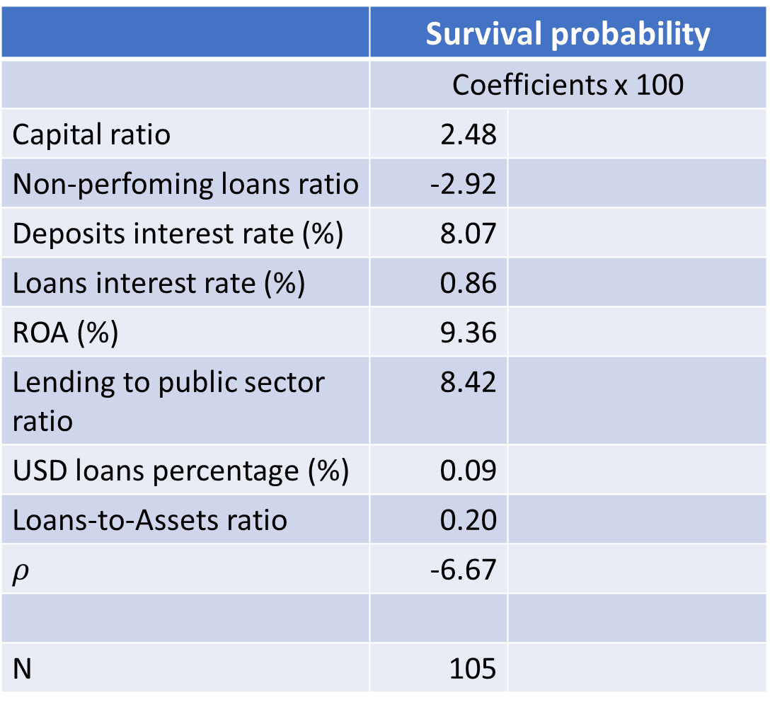



Results
 | Survival probability
 | Coefficients x 100
Capital ratio | 2.48
Non-perfoming loans ratio | -2.92
Deposits interest rate (%) | 8.07
Loans interest rate (%) | 0.86
ROA (%) | 9.36
Lending to public sector ratio | 8.42
USD loans percentage (%) | 0.09
Loans-to-Assets ratio | 0.20
$$ρ$$ | -6.67
N | 105
Spatial probit case
Predictors at 1998 (annual average)
Failure horizon is 2001q4
Predictors at 1998 (annual average)
Failure horizon is 2001q4
$$y^{∗}=ρW y^{∗}+Xβ+ε$$
$$ε∼𝓝\left(0,I\right)$$
$$E\left[\frac{∂y_{i}}{∂x_{k,i}}\right]={diag{\left\{φ\left( \hat{Y}\right)\right\}}_{k}\left(1−ρ\right)}^{−1} \hat{β_{k}}$$
$$[0,1]$$
$$E\hat{\left[\frac{∂y_{i}^{∗}}{∂x_{cap,i}}\right]}=0.88±0.33$$
Marginal effect capital < 0.88

Slide 18
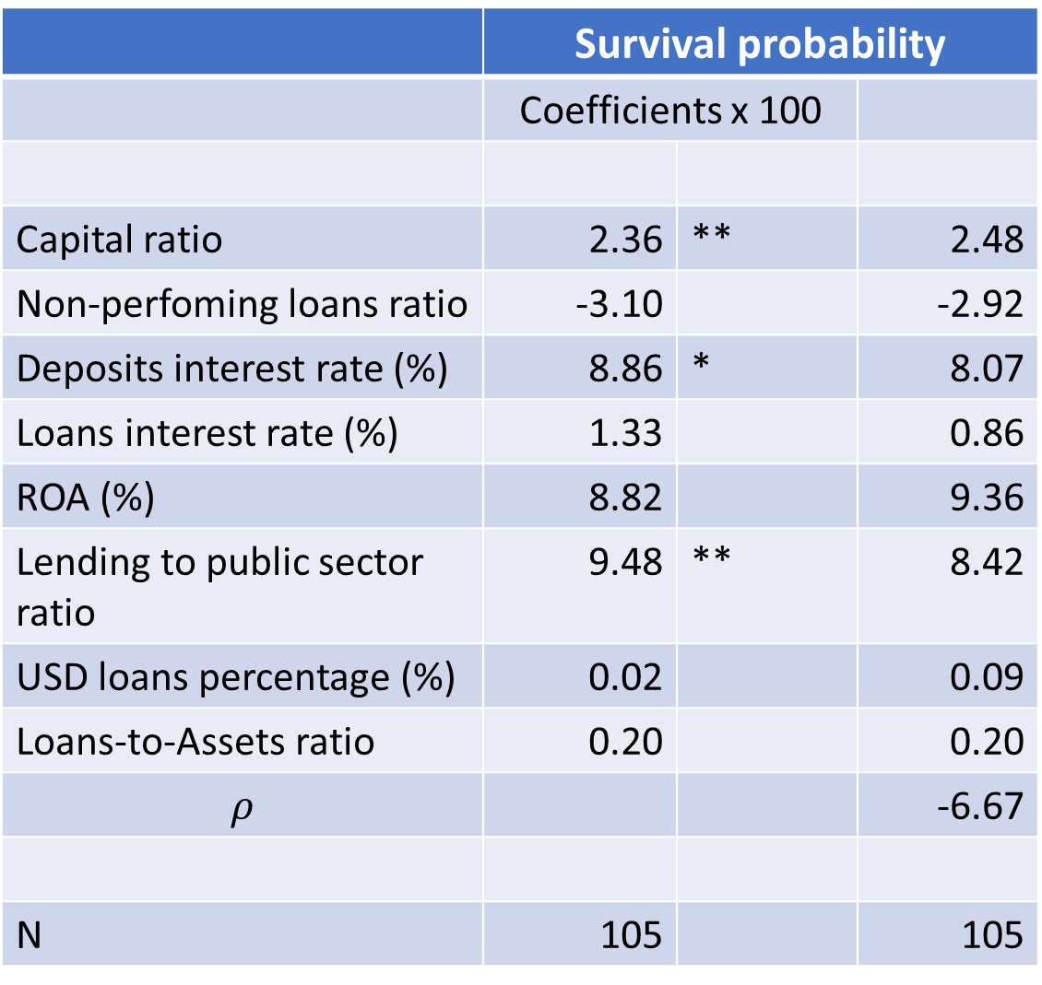
Results
 | Survival probability
 | Coefficients x 100
Capital ratio | 2.36 | ** | 2.48
Non-perfoming loans ratio | -3.10 |  | -2.92
Deposits interest rate (%) | 8.86 | * | 8.07
Loans interest rate (%) | 1.33 |  | 0.86
ROA (%) | 8.82 |  | 9.36
Lending to public sector ratio | 9.48 | ** | 8.42
USD loans percentage (%) | 0.02 |  | 0.09
Loans-to-Assets ratio | 0.20 |  | 0.20
$$ρ$$ |  |  | -6.67
N | 105 |  | 105
Probit case
Spatial probit case
Predictors at 1998 (annual average)
Failure horizon is 2001q4
$$E\hat{\left[\frac{∂y_{i}^{∗}}{∂x_{cap,i}}\right]}=0.88±0.33$$

Slide 20

What is capital ratio?
Bank balance sheet
ASSETS | LIABILITIES
Liquid assets | Deposits
Loans
 | Bonds issued
 | Net worth (capital/equity)
Others
Not reserve requirements!
Not K!
Contractual structure of the economy
Holmstrom, Tirole (1997), QJE
Calomiris & Kahn (1991), AER
$$Capital ratio=\frac{Equity}{ASSETS}$$
Basel I: > 8%
Notes:
Modigliano & Miller

Slide 21
Diamond & Rajan (2003)
Real model. What you want for Arg in the 90s
Banks have unique skilles: relationship loans. When a bank fails some the wealth associated with this unique skill is lost.
Macro shock is the proportion of ‘late’ projects that each bank has
A bank run is a consequence of aggregate liquidity shortfall
A banker wish not to reduce loans to firms, ie liquidate late projects.
Contagio ocurrs as a general equilibrium. No network, only one liquidity market. The interest rate rises as bank fails prompting more banks into failure. Bank failures may destroy early projects, thus creating less wealth (less liquidity).
A bank failure can generate more liquidity than the wealth it destroys.
From above, means that Macro shock size is unrelated to contagio. Arbitrarly large macro shocks do not generate contagio. A very large macro shock force ‘instantly’ enough bank failure generate enough liquidity to avoid a rise in r in the liquidity market. No matter how big the macro shock is

Slide 22

Marginal effects
Interbank loans
(Overnight) interbank market
Intercept | -0.6508
ActivoN | 5.41E-07
C8Est_w | 0.024895
CAR_IRR_3A6 | -0.02923
P_ROA | 0.093683
P_DEP_ARS_RATE | 0.080782
P_LOANS_ARS_RATE_W | 0.008664
APRSpNF_RATE_W | 0.084902
APR_USD_RATE | -0.00099
APR_RATE_W | -0.0023
rho | -0.06674
$$E\left[\frac{∂y_{i}}{∂x_{k,i}}\right]={\left(1−ρ\right)}^{−1} β_{k}$$
Interbank loans
“Virtually all such studies find that low capital ratios raise the probability of bank failure.” BERGER, ROMAN 2020
Notes:
Bank mutual relations comprise multiple areas: syndicated loans market (many banks lending the same borrower), overnight interbank market, derivative positions (or swaps), wholesale deposit market. We only consider loans reported in the credit registry.
Interbank market data relies on trading data. In some cases the identities of the parties is unknown

